Slide 1






BY:- GRISHAV PAUDEL

Slide 2
PROBLEM STATEMENT
A consumer finance company faces challenges in approving loans because some applicants have little or no credit history, making it difficult to assess their repayment ability. Some borrowers take advantage of this and default on their loans.
When a loan application is received, the company must decide:
Approve a reliable borrower → Risk: Rejecting a good applicant means losing business.
Deny an unreliable borrower → Risk: Approving a defaulter leads to financial loss.
Loan applications can have different outcomes:
Approved: The company grants the loan.
Cancelled: The client withdraws the application.
Refused: The company rejects the application.
Unused offer: The client cancels after initial approval.
Using Exploratory Data Analysis (EDA), you will examine customer and loan data to identify patterns that help predict loan defaults, ensuring that only applicants capable of repayment are approved

Slide 3
Approaches to the problem
1- understanding business problem statement
2- Load the data
3- check data type & missing values
4- summary statistics
5- handling duplicate & inconsistent variable
6- univariate and bivariate analysis
7 - plotting graph for insights
8 - summary or conclusion

Slide 4
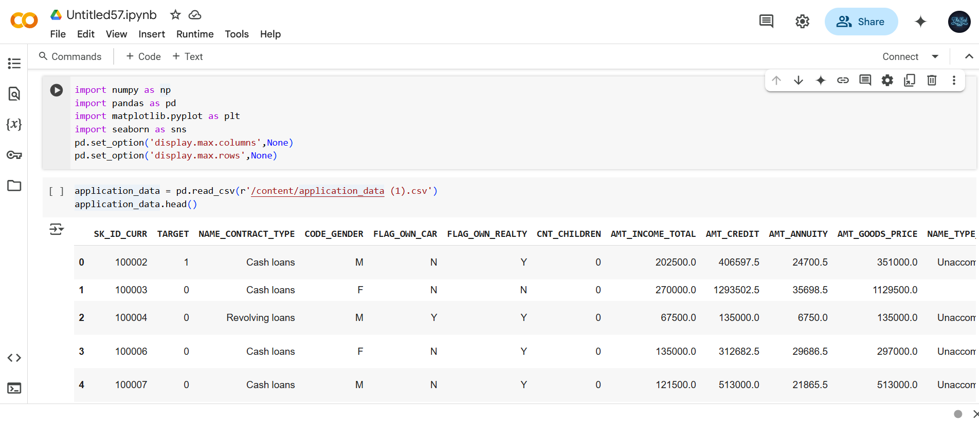
Load the data

Slide 5
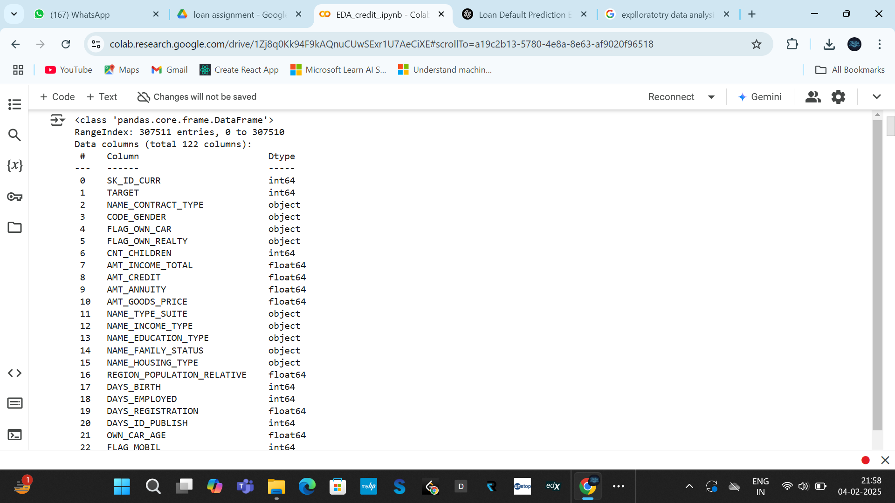
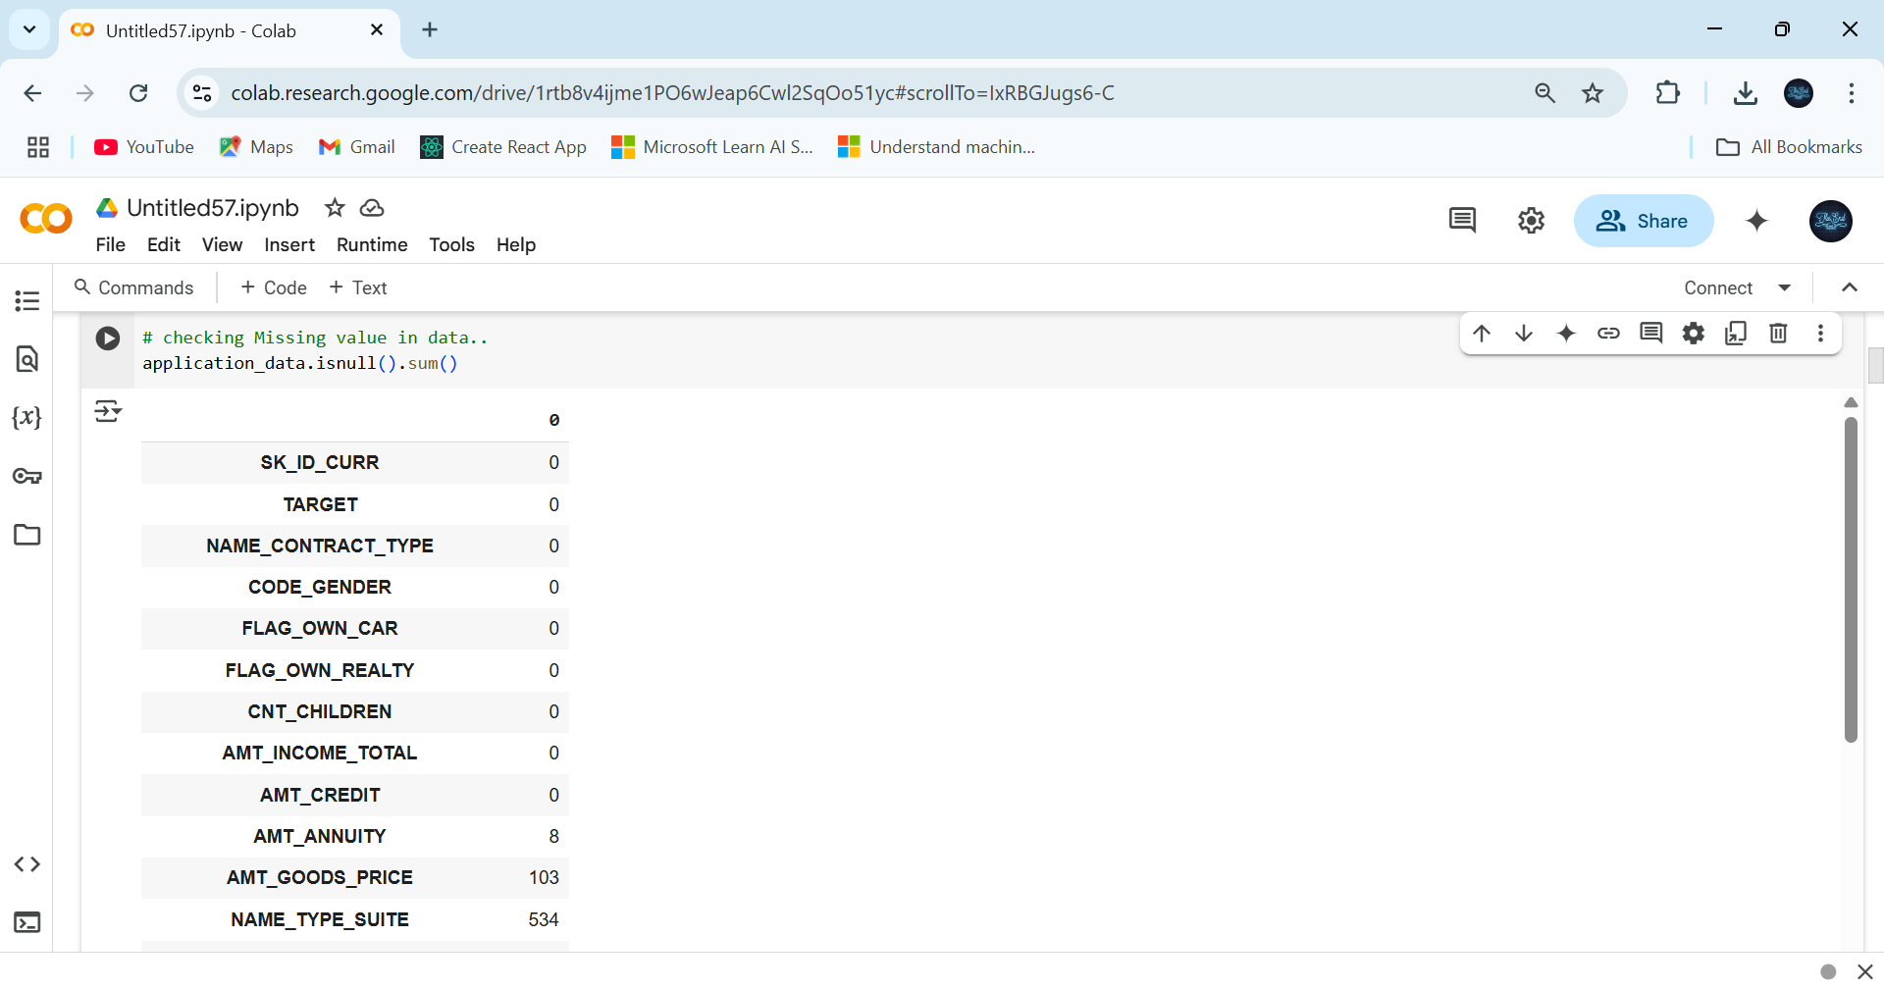
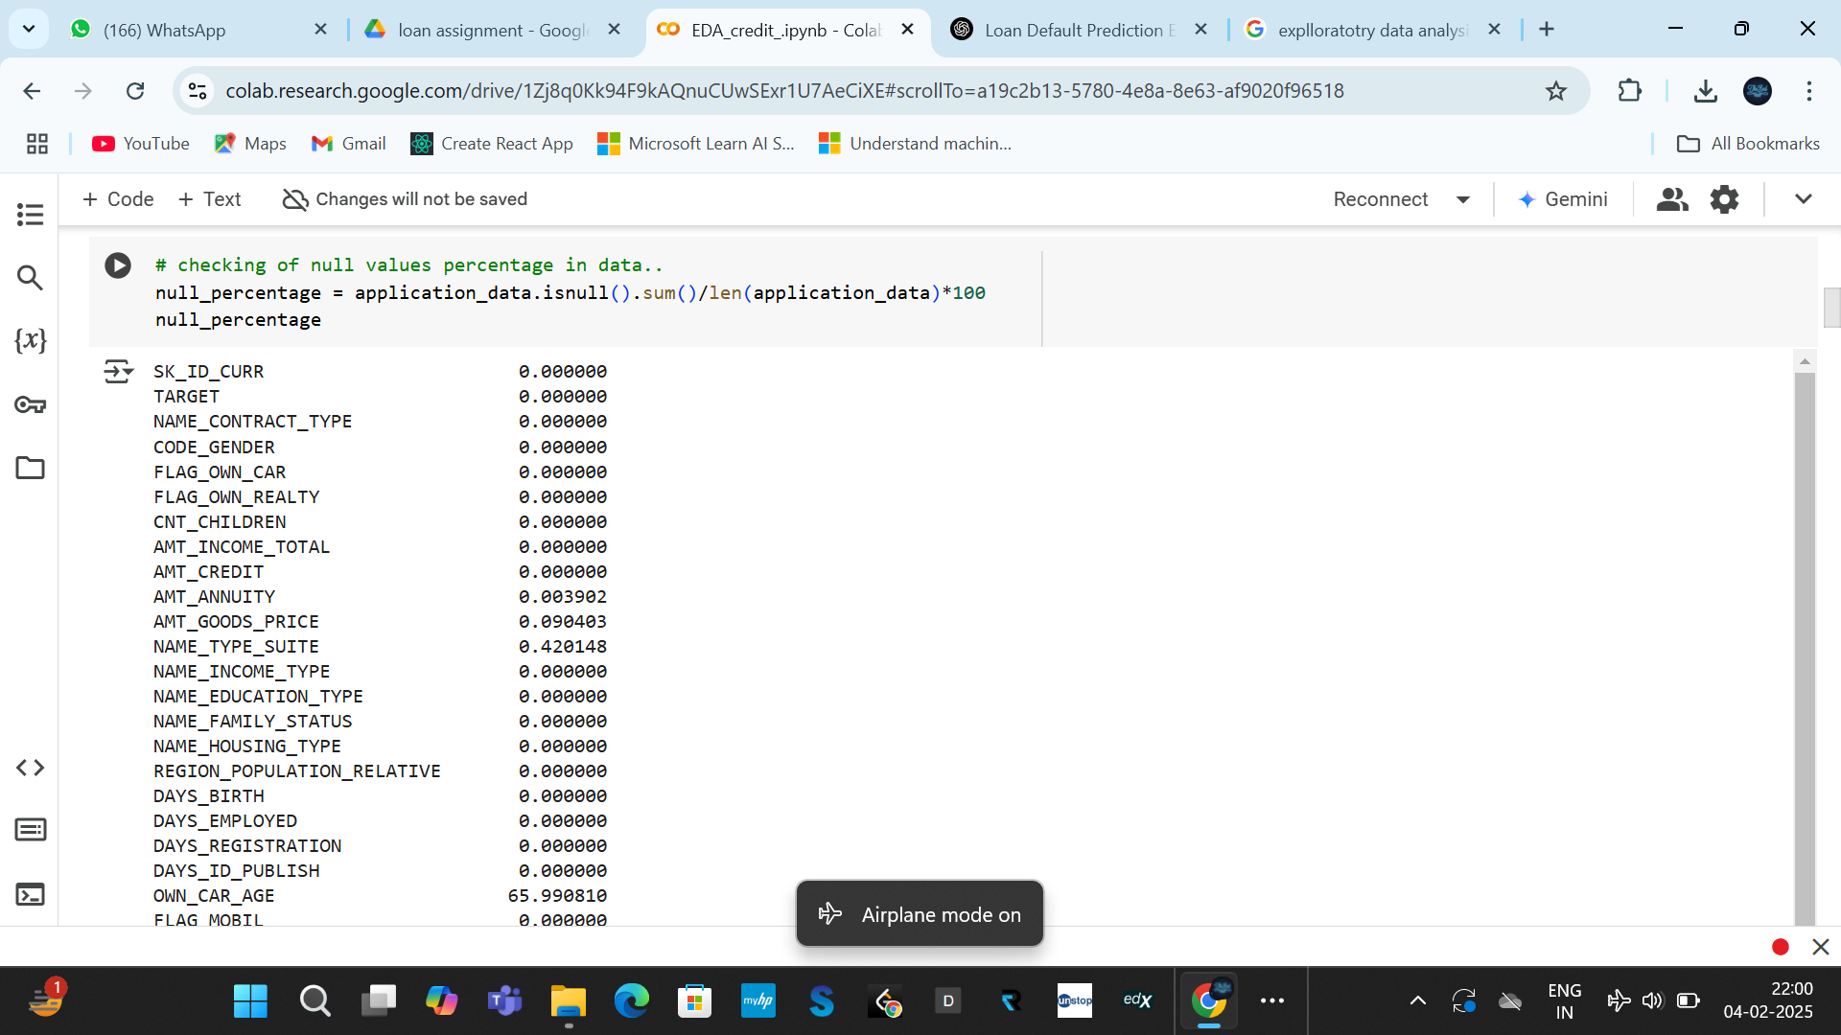
Check data type & missing values

Slide 6
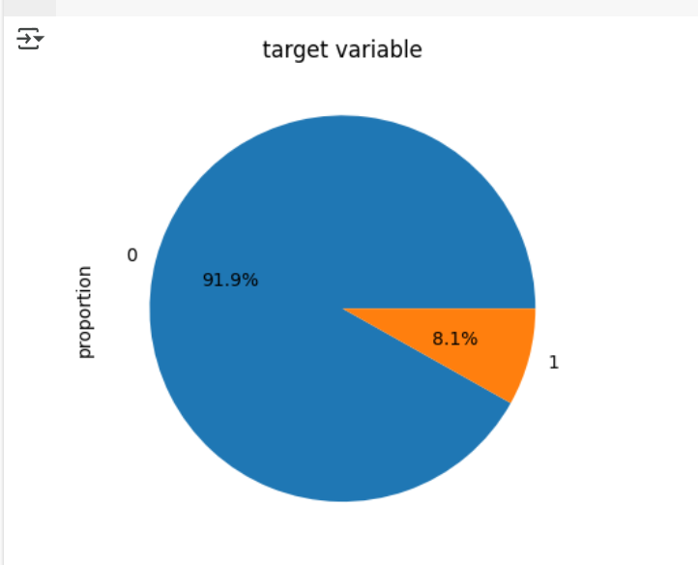
Analysing Target Variable
The 8.1% clients faced difficulty and the 91.93% clients paid on time..
Data Imbalance Ratio : 11.28

Slide 7
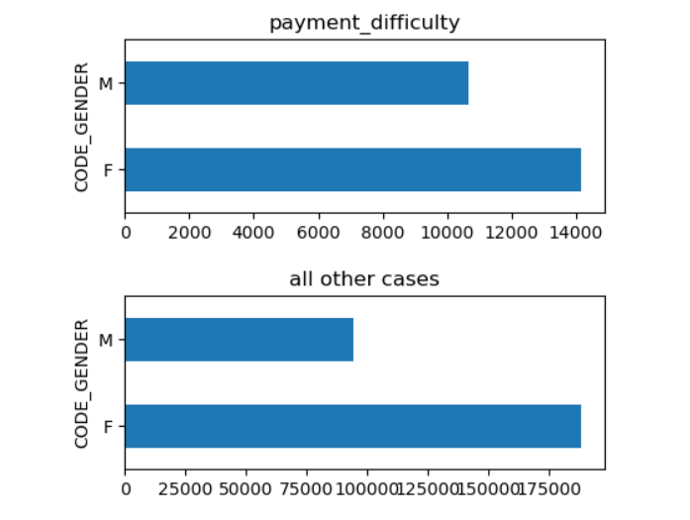
Analysing gender variable
we have seen the Male gender faced difficulty in payment.
while on the other hand females are on much safer option than male.

Slide 8
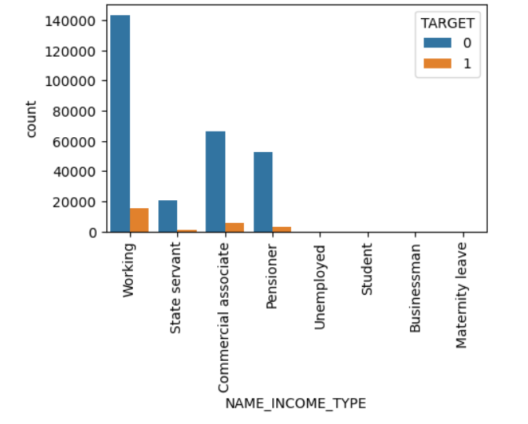
Analysing Income type with Target Variable
Working, commercial associate ,pensioner, state servant groups faces no payment issue.

Slide 9
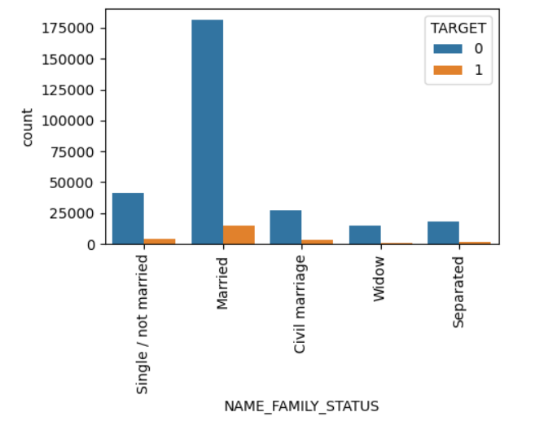
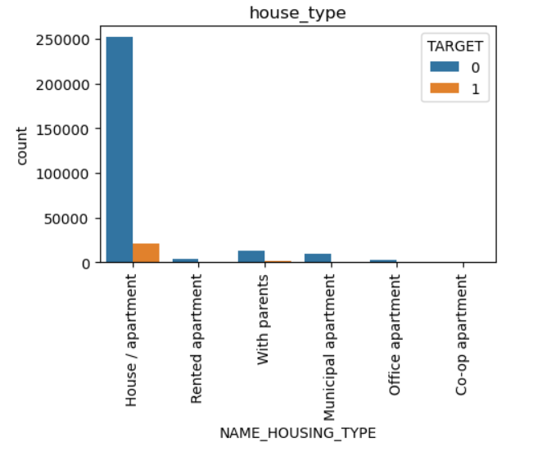
Analysing Family Status
Analysing Housing Type
Here married people are safer side to grant loan
People have house/apartment are safer choice.

Slide 10
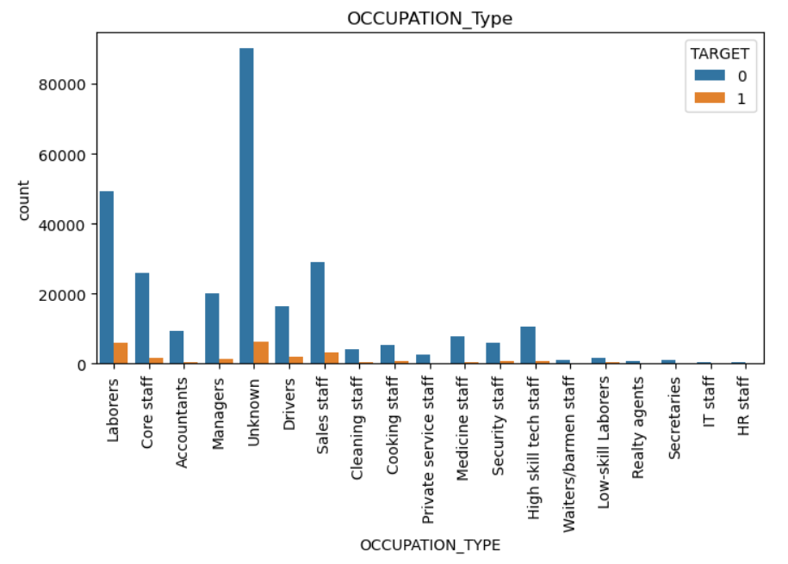
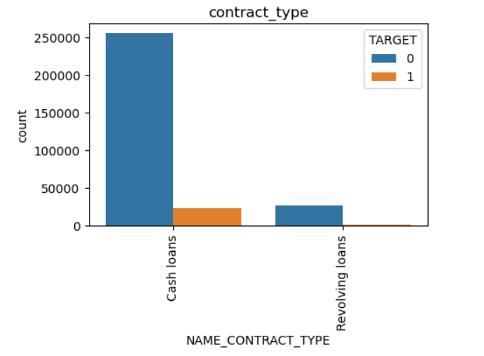
Analysing Occupation Type
Analysing Contract Type
Laborers and accountants occupation type have less defaulters.
low skilled occupation could be avoided to give loans.
Cash loans are easier for people to pay back.

Slide 11
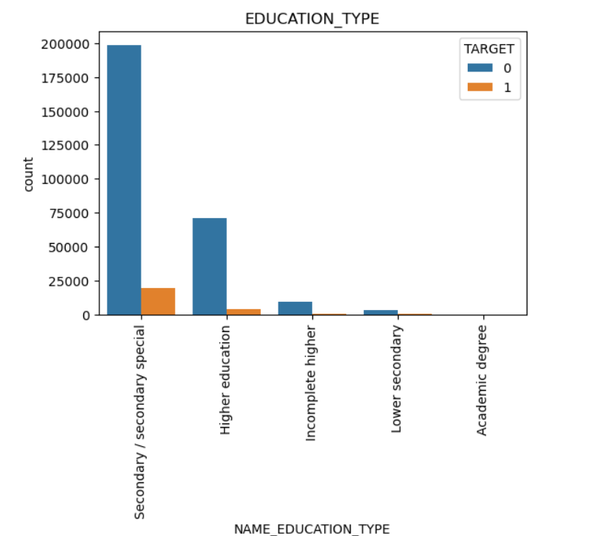
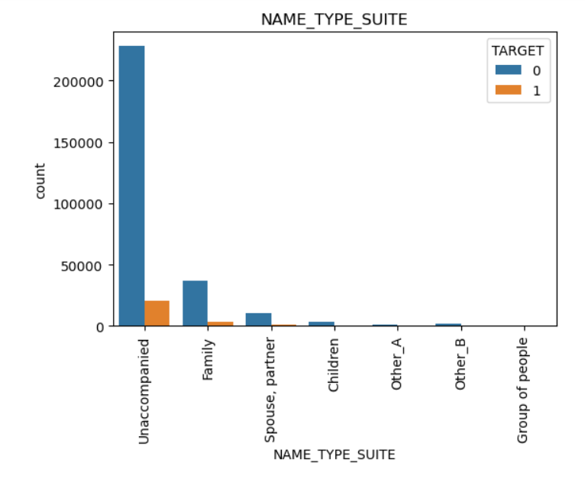
Analysing Education Type variable
Analysing Name Type Suite
Higher and Secondary education clients have most likely to repayed loan.
Unaccompanied and family are safer segments..

Slide 12
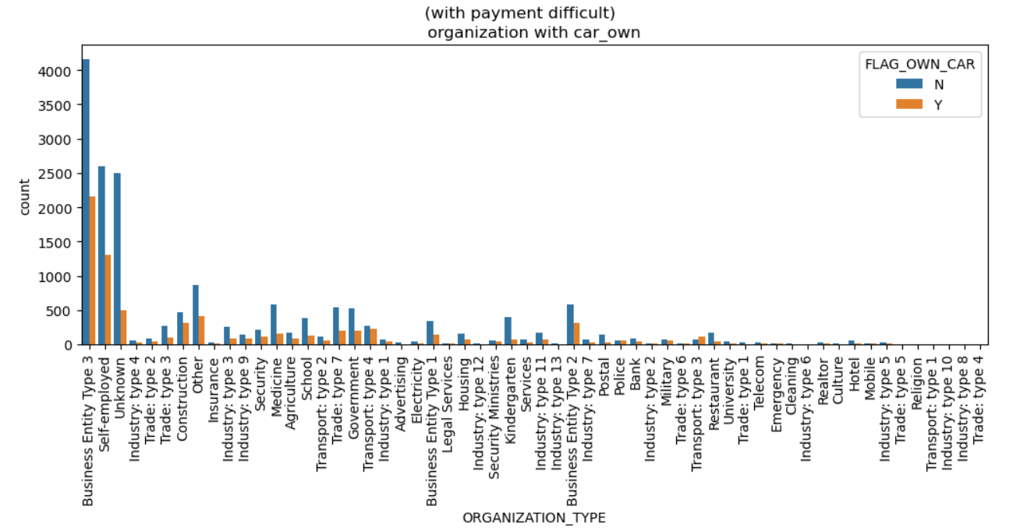
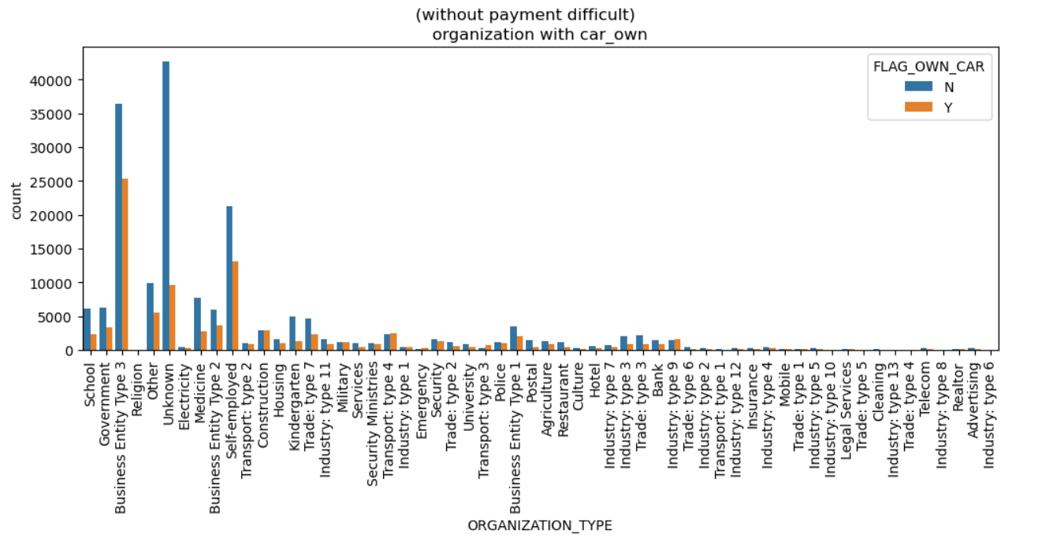
Analysing Organization Variable
Self - employed clients who don't own a car have more payment difficulties compared to on time payment

Slide 13
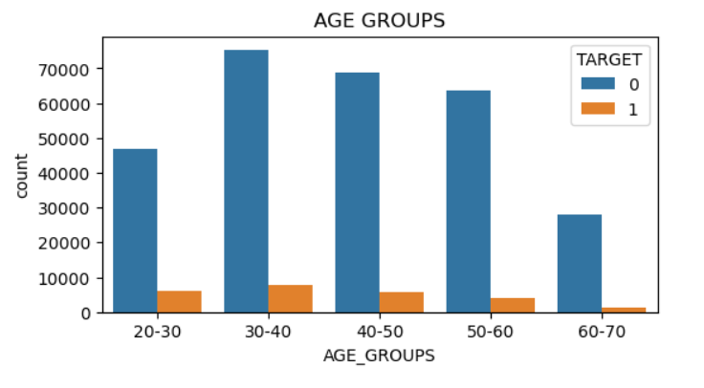
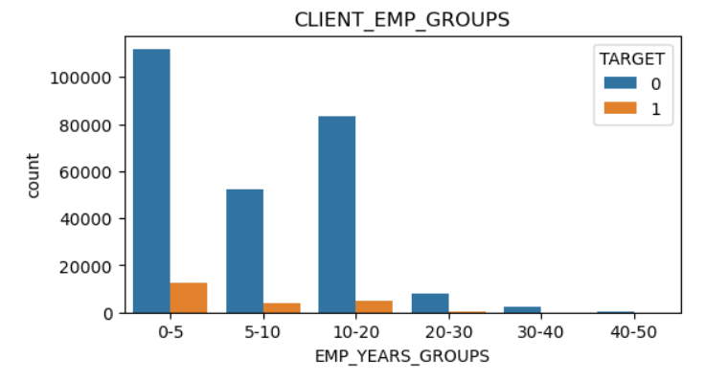
Analysing Age groups Variable
Analysing Employed Years
Clients Age group of 30-50 shows impressive results.
Clients in the age brackets of 30-40 and 40-50 are in their young age and perfect group to provide loans
Those clients employed for (0-5) years and (10-20) years could be the best groups for granting loans.
As they faces no payment issue as well..

Slide 14
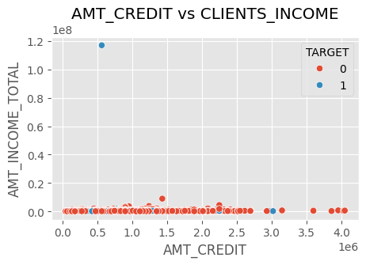
Analysing Amount_credit vs Clients_Income
As we can see most of defaulter are between AMT_CREDIT of (0-1.5 million) range..
Moreover most clients income range around 1 million..

Slide 15
Recommendation
1- previous clients with good credit score and repeaters should be given loans.
2-Unemployed category can be avoided
3- low level income groups should be neglected
4- cash loans should be offered more rather than revolving loans
5-Female clints are more suitable for lending loan than men.
6-Married catagory people should be targeted.

Slide 16
Summary
Loan companies struggle to approve applications due to insufficient credit history.
The risk involves approving defaulters (financial loss) or rejecting good borrowers (missed business opportunity).
EDA helps analyze patterns in customer and loan attributes to predict loan repayment behavior.
The dataset includes customer details (income, job, credit history) and loan details (amount, tenure, status).
EDA techniques like data cleaning, feature analysis, and visualization help find risk factors.

Slide 17


Thank you

